Slide 1

Experimental project: Real Time Locating System
Vincenzo Panacciulli - Maria Mucciacito - Daniele Caterina | 24/04/2023 - 19/07/2023

Slide 2
Summary
Goal
System design
Cloud and Devices
Installation and calibration of anchors and tags
Application Functionality

Slide 3

Goal
Experiment with the use of IoT devices in order to improve the efficiency of the activities
production and logistics.
This goal is to be achieved through the optimization of operators' activities in the workplace.

Slide 4
Our Solution
The company faced the need of optimizing the employers’ movements around a work center in order to enhance their working experience.
Our solution creates automatically a spaghetti chart leveraging IoT devices (UWB) that can show the movement of entities within the map, so as to be able to track the locations with the most congestion and which slow down the efficiency in the place.

Slide 5
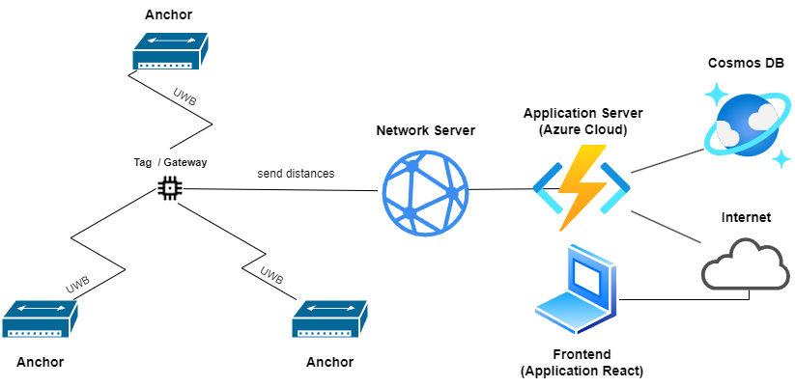
RTLS Architecture
Real-Time Locating System is an architectural pattern for precise, real-time localization and identification of the position and movements of entities in a delimited environment.

Slide 6
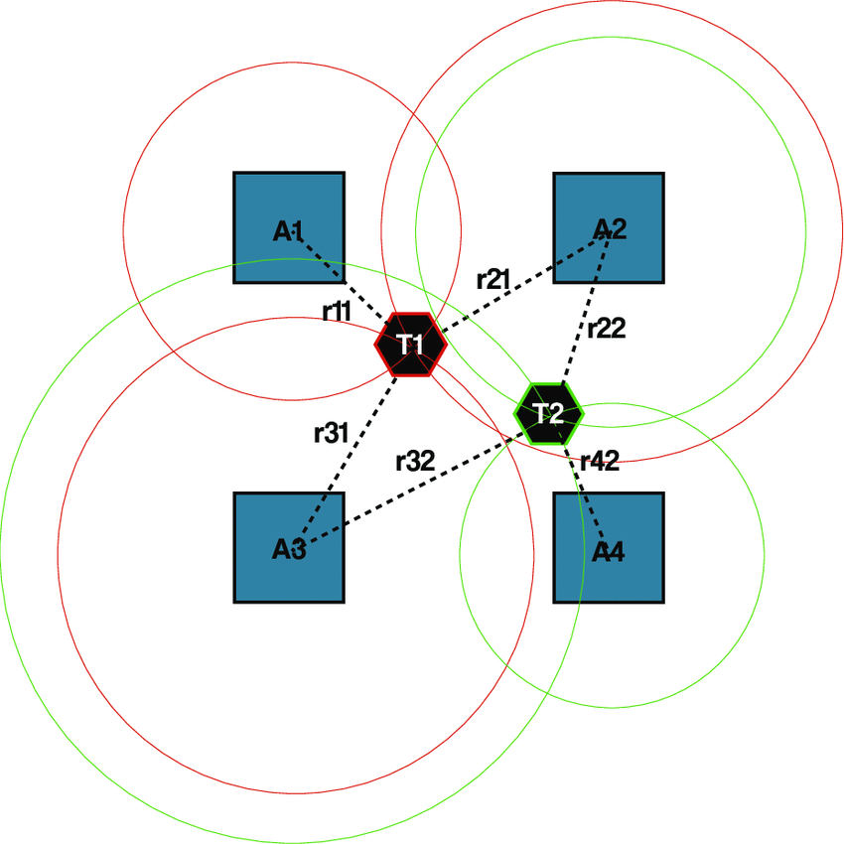
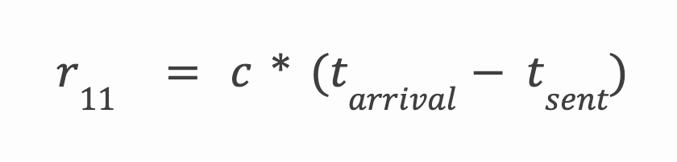
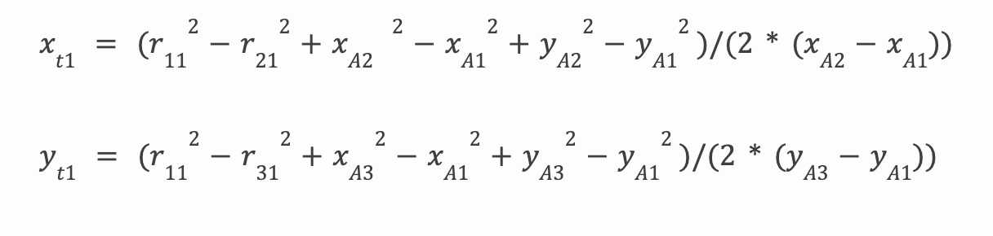
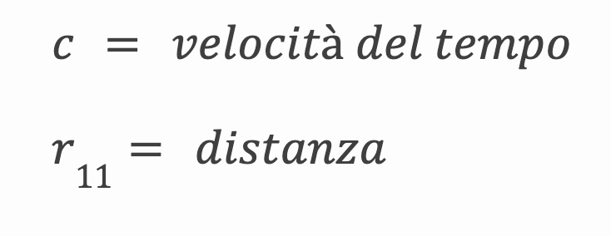
TDOA: Time Difference Of Arrival
Measurement of the time difference in which the signal arrives from different locations
Trilateration
Distance calculation:
Calculation of coordinates:
Time velocity
distances

Slide 7



Backend: Azure Cloud
We use Azure Cloud services as Backend
Azure Cosmos DB
Azure Functions (serverless)
HttpTrigger
TimerTrigger

Slide 8

Network Ultra Wide Band
PRO
Precisione ⋍ 10 cm
Bassa Interferenza
Resistenza a interferenze
metalliche
Ampia scelta di frequenze
Utilizzata nell’industria
A short-range wireless communication technology that transmits high-frequency, low-power radio signals across a wide range of frequencies. UWB technology can transmit data at high speed while providing very high positioning accuracy.
PROS
Low Interference
Resistance to metallic interference
Wide choice of frequencies
Industrializable

Slide 9
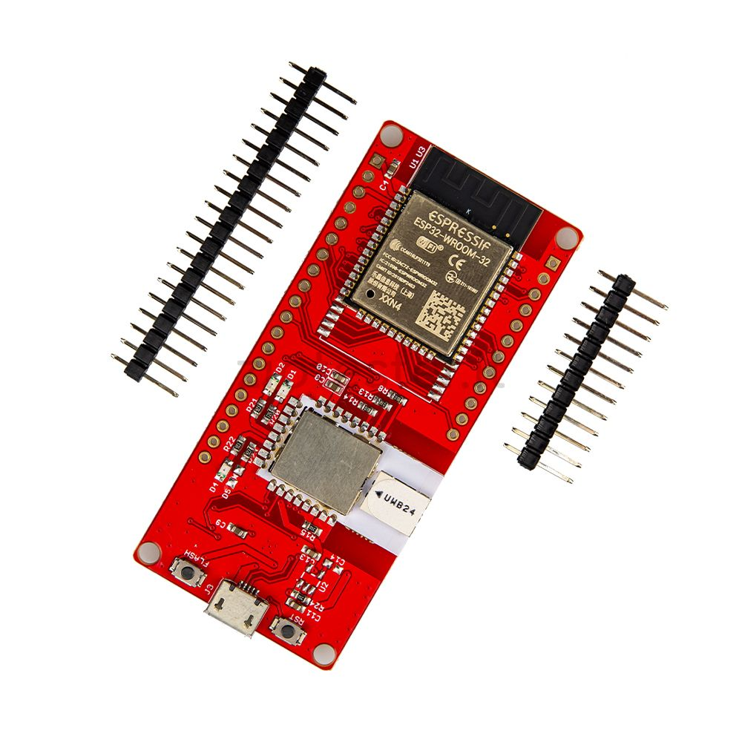

Hardware Arduino DW3000 ESP32 UWB
Type: Active tag
It can connect to WiFi networks as well as the UWB network
Can be either a tag or an anchor
More resistant to interference than competitors

Slide 10
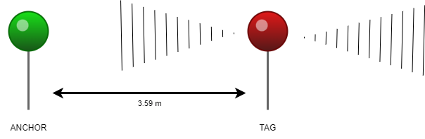
Communication between devices
The Anchor sends a signal to any Tag that responds, the Tag received the signal and its distance.
Finally, the data is sent to the Back End and processed.
TAG
ANCHOR

Slide 11





Languages
Front end: React + TypeScript
Back end: C#
Arduino: C++
Main Libraries:
React Leaflet
Chakra UI

Slide 12
Functionality
Track the movement of the tag in the area
Set the positions of the devices in the area
Set sites and machines

Slide 13
Next possibly update
Create a history of the movements
Details of the recordings
Possibility of recovering the settings of a record setup
Adding an image as a map for each site

Slide 14
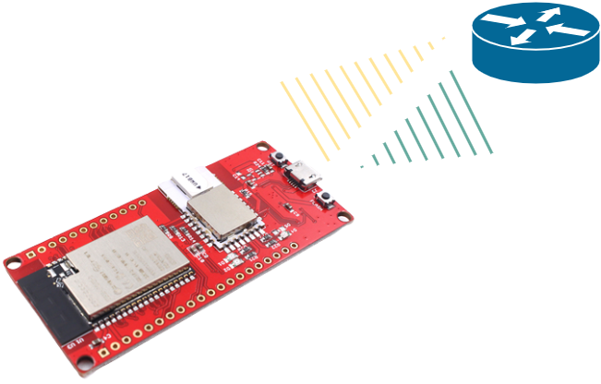
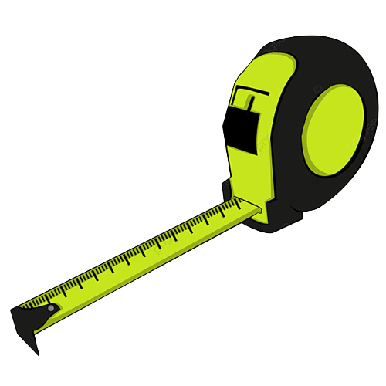
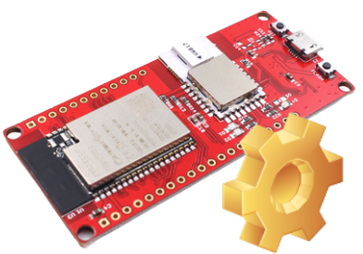
Calibration
of devices

Slide 15
Demo

Slide 16

Thanks for your time!
Contacts
Vincenzo Panacciulli:
panacciullivincenzo@gmail.com
Maria Mucciacito:
mucciaccitomaria@gmail.com
Daniele Caterina: danielecaterina2002@gmail.com
Project: https://github.com/orgs/RTLSWizards/repositories

